Slide 1
Healthcare Data Insights Report (2019–2024)
Strategic Dashboard Summary for Leadership
Presented by: Tolulope Olarewaju
23rd June 2025.

Slide 2
Overview
What This Is: A summary of patient trends, hospital operations, and billing insights.
Why It Matters: Helps us improve care, reduce costs, and allocate resources better

Slide 3
Key Metrics
✅ 55.5K Patients
✅ Average Age: 51.5
✅ Avg. Stay: 15.5 Days
✅ Billing Total: $1.4B
✅ Top Condition: Hypertension
✅ Top Insurer: Medicare

Slide 4
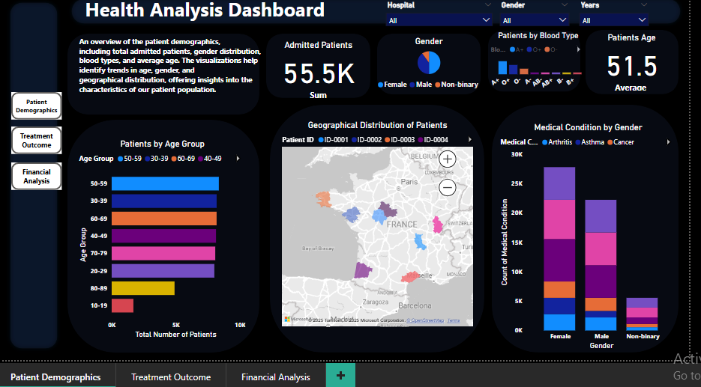
Patient Demographics
Insights:
Majority aged 50–59 → Plan for age-related care.
50% Female → Gender-responsive programs needed.
A+ is the most common blood type.
Action:
Target high-density regions and at-risk age groups.

Slide 5
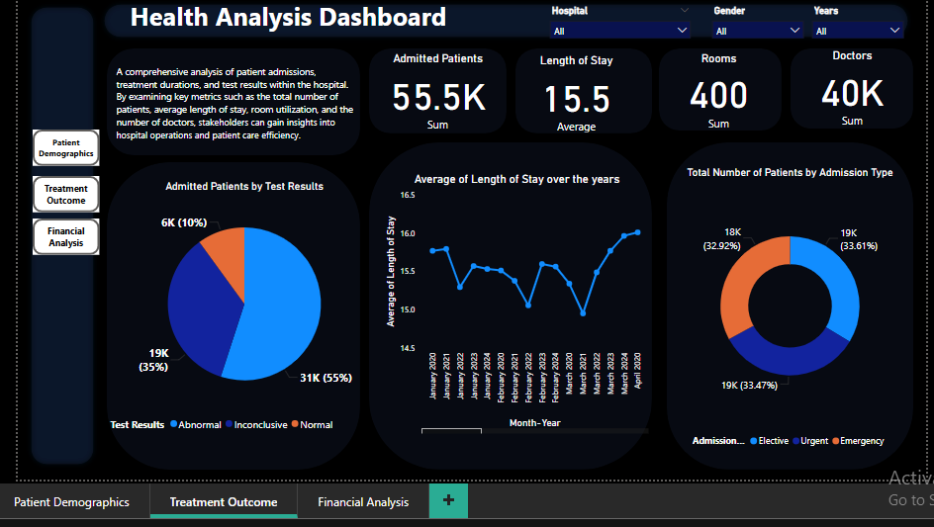
Hospitalization & Treatment
Insights:
Length of stay stable over 5 years (avg. 15.5 days)
55% had abnormal test results → Need better diagnostics
Balanced emergency, elective, urgent cases
Action:
Introduce faster diagnostics
Adjust staffing based on admission patterns

Slide 6
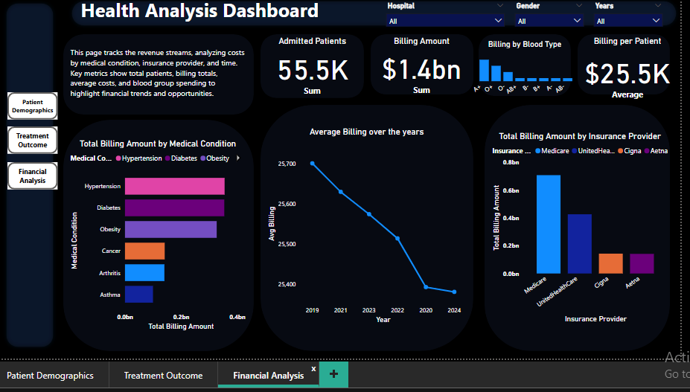
Financial & Insurance Overview
Insights:
Avg. billing per patient: $25.5K
Hypertension → highest billing condition
Medicare accounts for $707M in billing
Action:
Optimize billing for chronic conditions
Strengthen Medicare & UHC relationships

Slide 7
Strategic Recommendations
✅ Launch care programs for the 50–59 age group
✅ Improve test accuracy to reduce inconclusive results
✅ Review insurer contracts for better margins
✅ Prioritize chronic care billing optimization

Slide 8
Thank you

